Slide 1
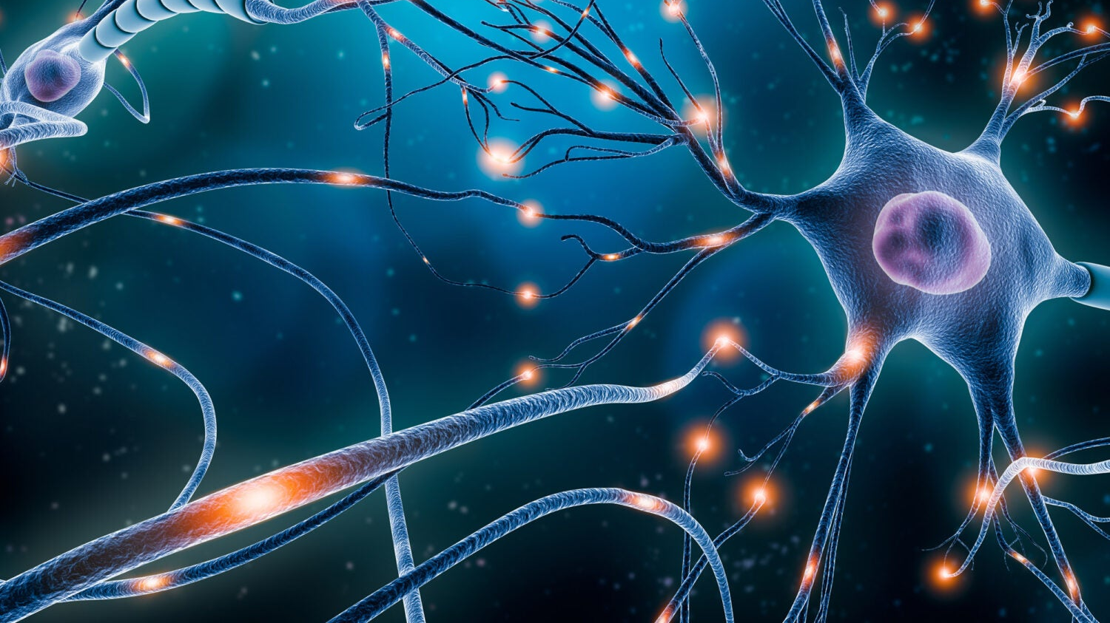
Nervous System Actions
Jawwad Khaled
Class 9 B-1

Slide 2
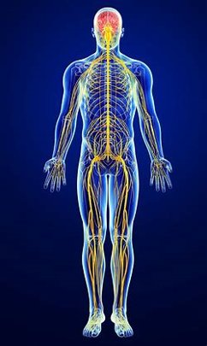
Sensations
Sensations: These are when you feel something, acknowledge, you felt it, but do not do anything. Like when you touch a cold surface. You felt the cold surface, you knew it was cold, but no effectors were affected. The pathway for a sensation is below.
Receptor -> Sensory Neuron -> Relay Neuron In Spinal Cord -> Brain
On the next slide, is an example of a sensation.

Slide 3
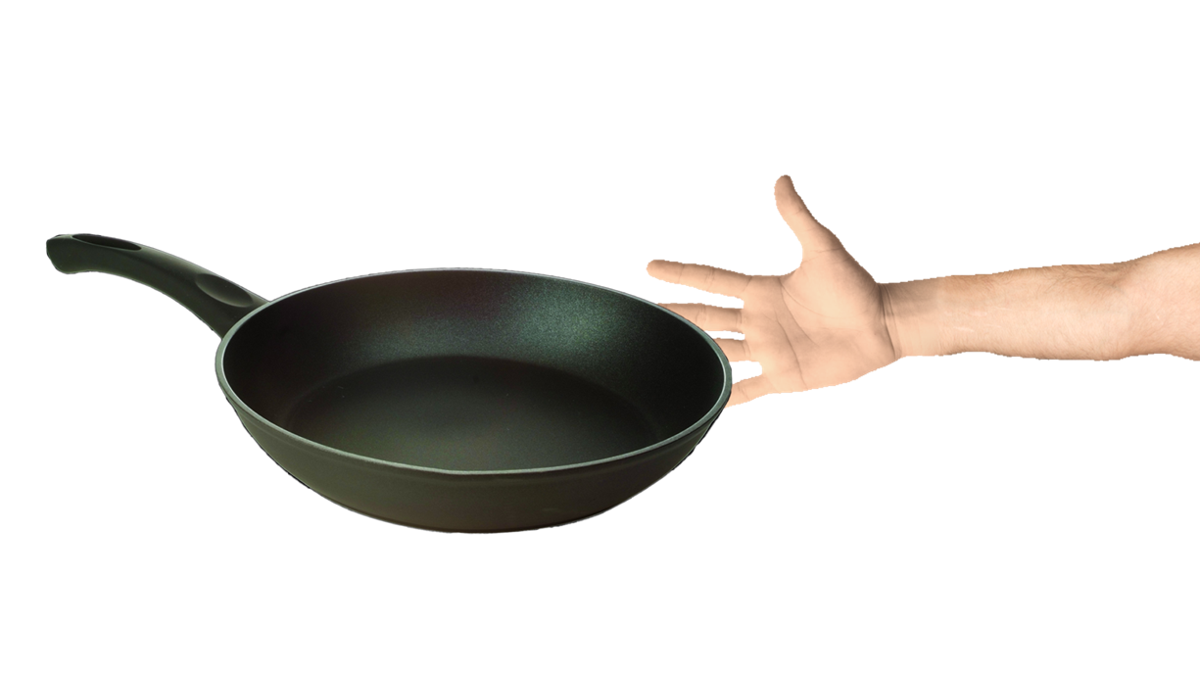
Sensation Example
In the following example, you touch a pan before it is heated.

Slide 4
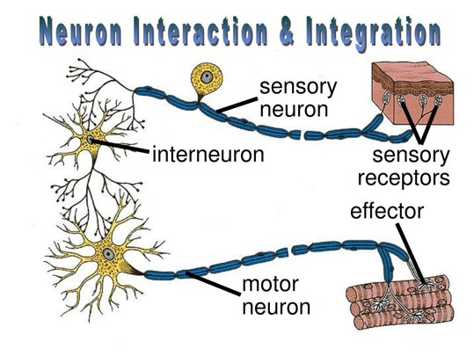
Voluntary Actions
Voluntary Actions: These are actions that you do that happen under your conscious will. They do not involve sensory neurons. These are actions you chose to do so these impulses are formed in the brain. An example is raising your hand in class. The pathway for a voluntary action in below.
Brain -> Relay Neuron In Spinal Cord -> Motor Neuron -> Effector
On the next slide, is an example of a voluntary action.

Slide 5
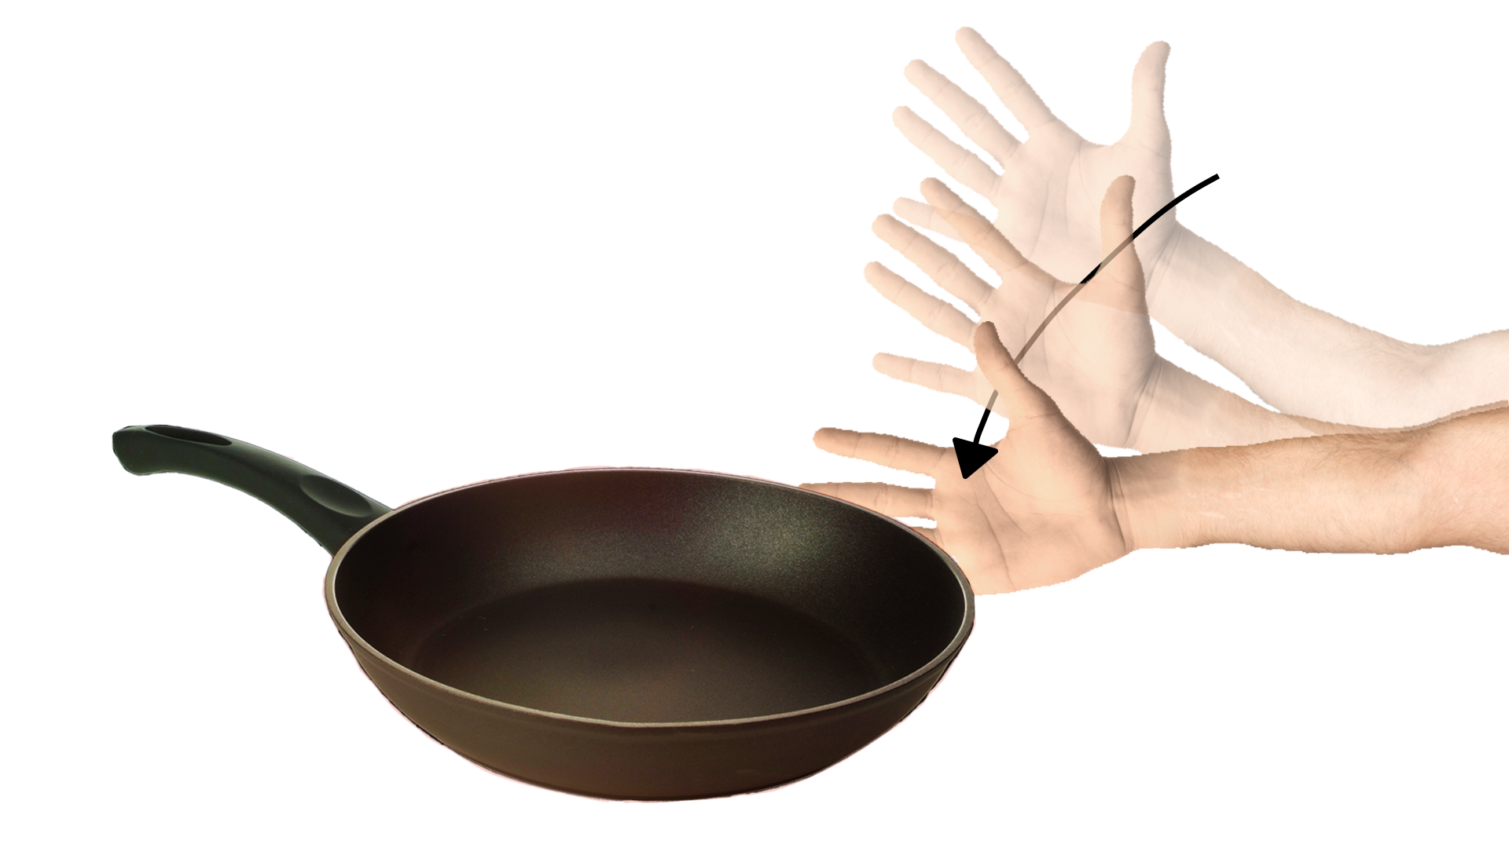
Voluntary Action Example
In the following example, you decide to touch a pan after it is heated.

Slide 6
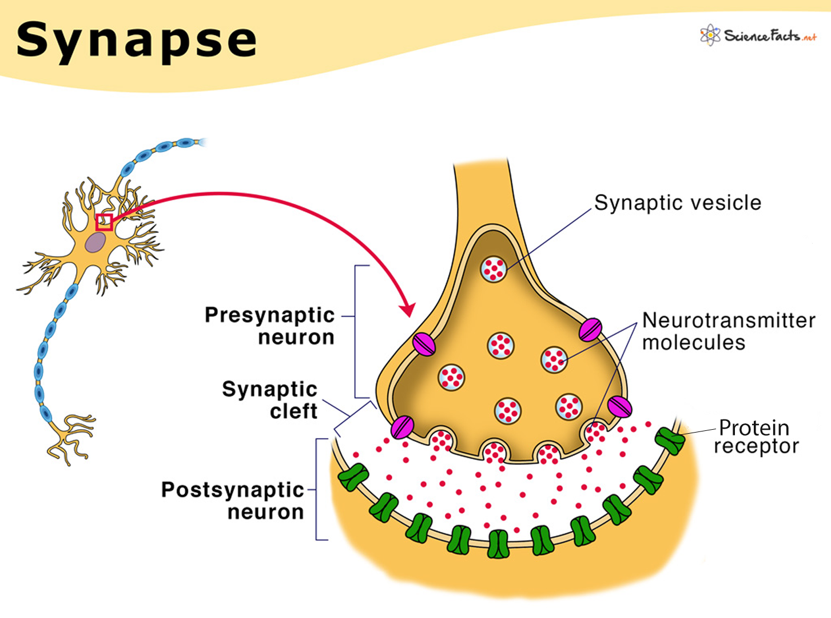
Reflex Actions
Reflex Actions: A reflex action is an immediate response to a specific stimuli without conscious control. They are examples of involuntary actions. Reflex actions are immediate and much faster than voluntary actions. The spinal cord and brain are reflex centers. Reflex actions involve both sensory neurons and motor neurons. The pathway for a reflex action is below.
Receptor -> Sensory Neuron -> Relay Neuron In The CNS -> Motor Neuron -> Effector
On the next slide, is an example of a reflex action.

Slide 7
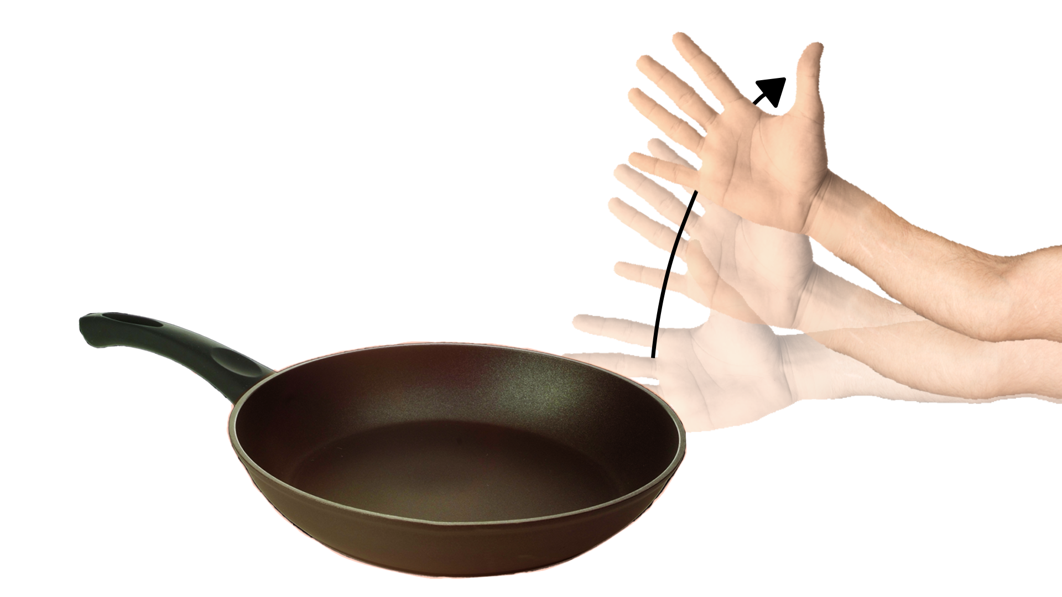
Reflex Action Example
In the following example, you actually touch a pan after it is heated.

Slide 8
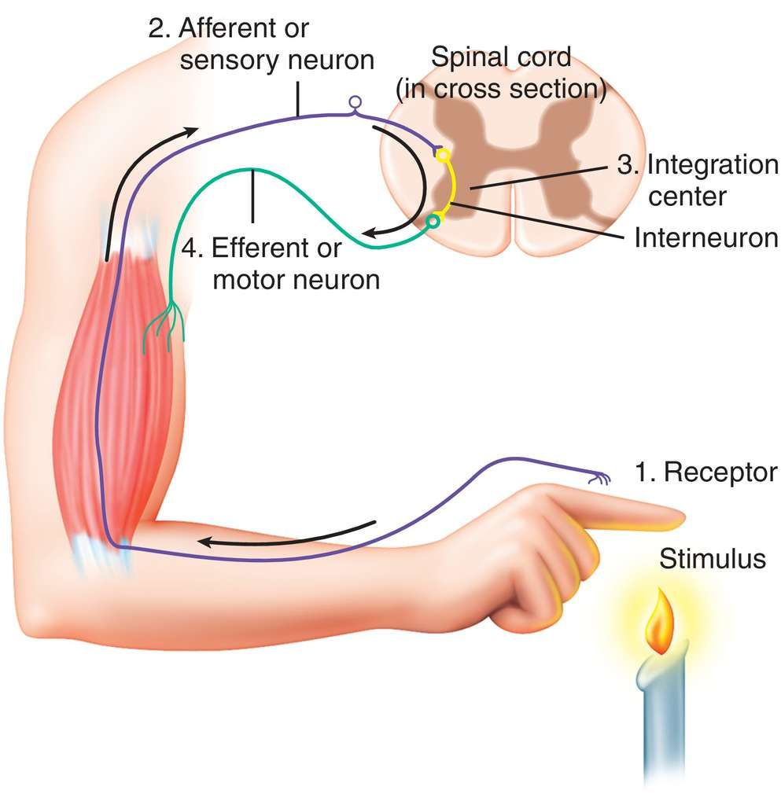
Reflex Arc
In reflex actions, a special pathway is taken. This pathway delays the information reaching the brain so that the reflex action can be completed faster to remove the body from potential harm. This pathway is called a reflex arc.
Receptor -> Sensory Neuron -> Relay Neuron In The CNS -> Motor Neuron -> Effector

Slide 9
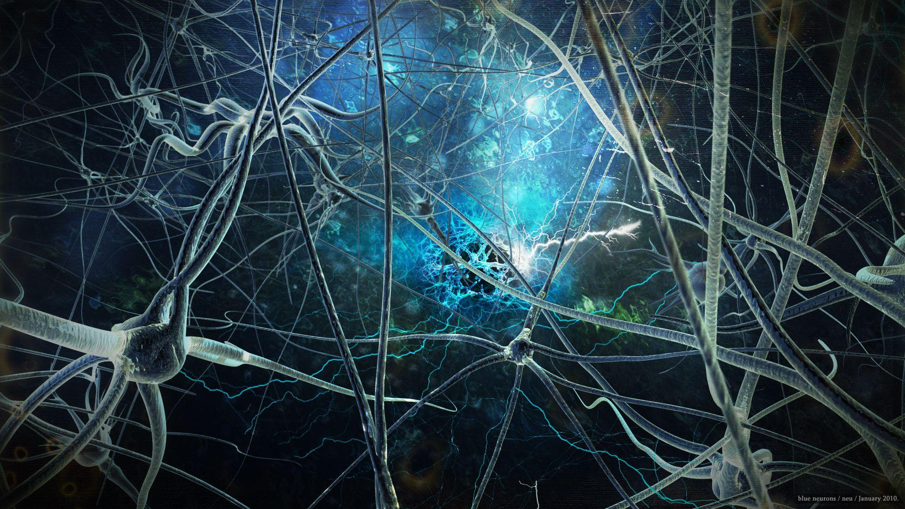
End Of Presentation
In this presentation we went over:
Sensations
Voluntary Actions
Reflex Actions
Thank you for listening to my presentation and have a nice day.

